Slide 1
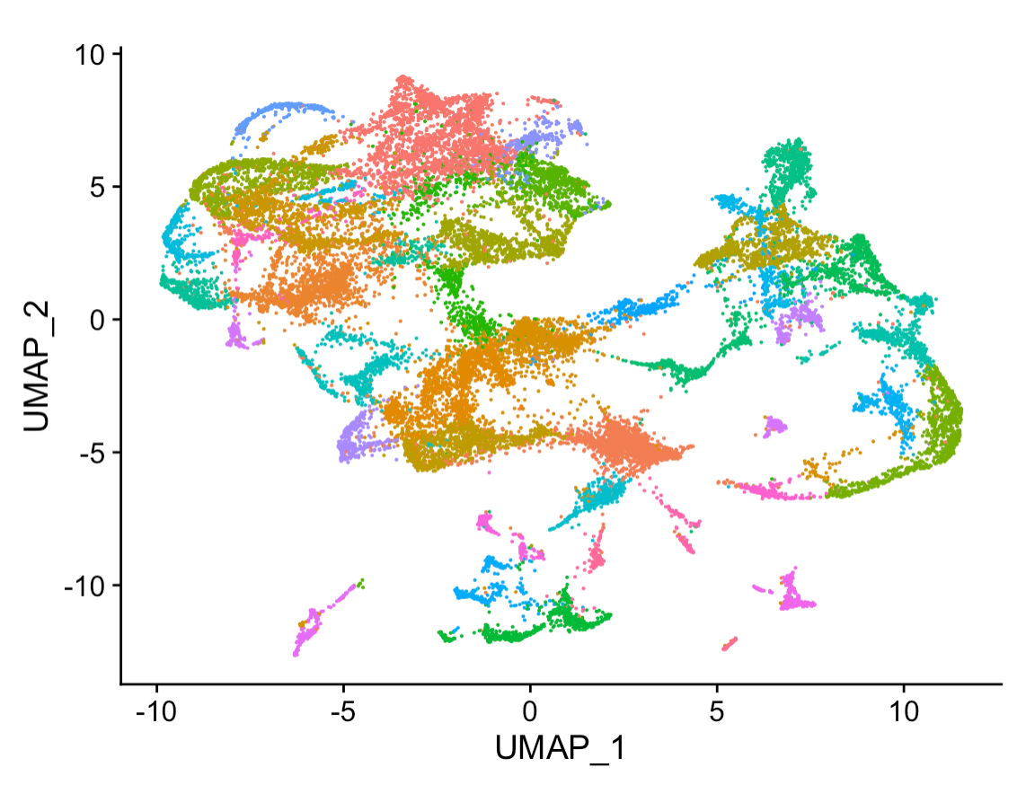
Un-supervised Learning Data4ML

Slide 2
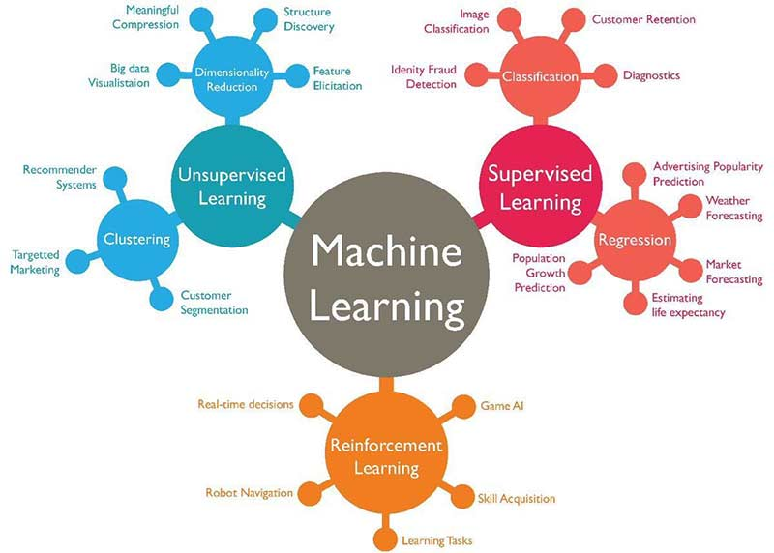

Slide 3
Introduction
Supervised learning: discover patterns in data with a known target (class) or label.
These patterns are then utilized to predict the values of the target attribute in future data instances.
Unsupervised learning: The data has no target attribute.
We want to explore the data to find some intrinsic structures in them.

Slide 4
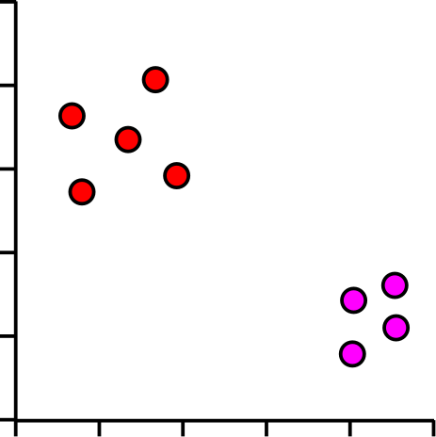
Dimensionality Reduction
Gene | Description | Cell 1 | Cell 2 | Cell 3 | Cell 4 | Cell 5
Inpp5d | inositol polyphosphate-5-phosphatase D | 7.00 | 5.45 | 5.89 | 6.03 | 5.75
Aim2 | absent in melanoma 2 | 3.01 | 4.37 | 4.59 | 4.38 | 4.18
Gldn | gliomedin | 3.48 | 3.63 | 4.61 | 4.70 | 4.74
Frem2 | Fras1 related extracellular matrix protein 2 | 4.75 | 4.66 | 3.46 | 3.74 | 3.45
Rps3a1 | ribosomal protein S3A1 | 6.10 | 7.23 | 7.44 | 7.36 | 7.34
Slc38a3 | solute carrier family 38, member 3 | 1.90 | 3.16 | 3.52 | 3.61 | 3.19
Mt1 | metallothionein 1 | 5.07 | 6.49 | 6.46 | 6.04 | 6.05
C1s1 | complement component 1, s subcomponent 1 | 2.74 | 3.02 | 3.86 | 4.10 | 4.10
Cds1 | CDP-diacylglycerol synthase 1 | 4.55 | 4.22 | 3.80 | 3.16 | 3.12
Ifi44 | interferon-induced protein 44 | 4.82 | 4.52 | 3.87 | 3.42 | 3.59
Lefty2 | left-right determination factor 2 | 6.95 | 6.28 | 5.88 | 5.60 | 5.61
Fmr1nb | fragile X mental retardation 1 neighbor | 4.28 | 2.78 | 3.10 | 3.25 | 2.57
Tagln | transgelin | 7.93 | 7.91 | 7.20 | 7.02 | 6.68
What you have is a lot of features
What you want is a few features you can look at
Keep only the important information
What counts as important?

Slide 5
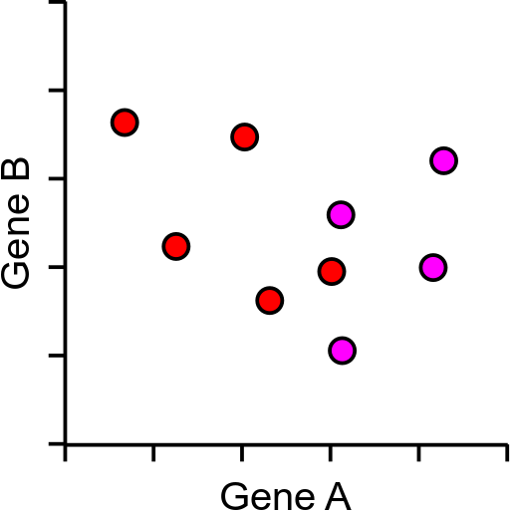
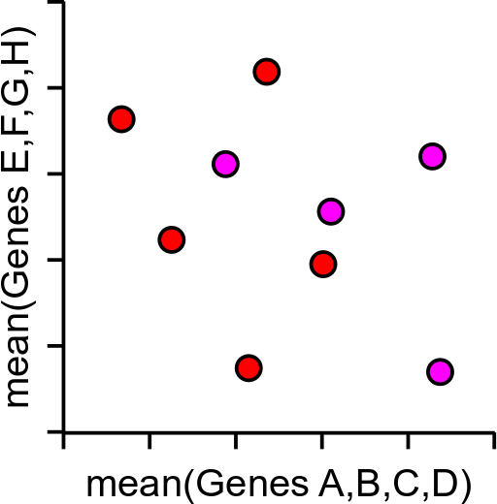
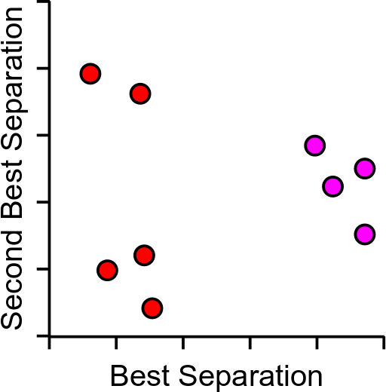
Too Much Data
5000 cells and 2500 measured genes
Realistically only 2 dimensions we can plot (x,y)

Slide 6
Principal Components Analysis (PCA)
Method to optimally summarise large multi-dimensional datasets
Can find a smaller number of dimensions (ideally 2) which retain most of the useful information in the data
Builds a Linear recipe for converting large amounts of data into new more useful features, called a Principle Component (PC), eg:
PC = (GeneA*10)+(GeneB*3)+(GeneC*-4)+(GeneD*-20)…

Slide 7
Principal Components Analysis (PCA)
Method to optimally summarise large multi-dimensional datasets
Can find a smaller number of dimensions (ideally 2) which retain most of the useful information in the data
Builds a recipe for converting large amounts of data into a single value, called a Principle Component (PC), eg:
PC = (GeneA*10)+(GeneB*3)+(GeneC*-4)+(GeneD*-20)…

Slide 8
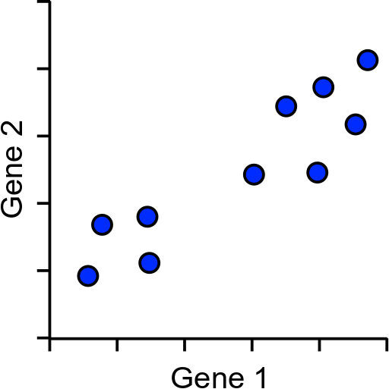
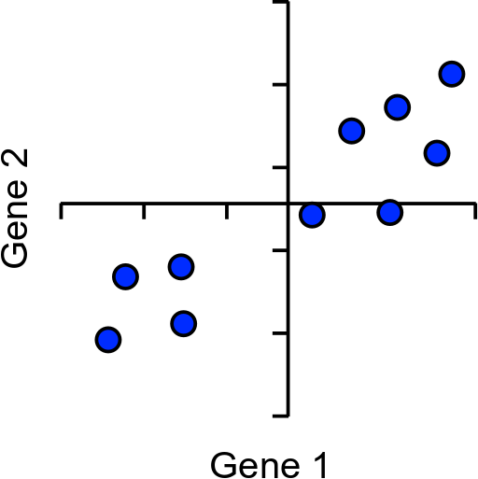
How does PCA work?
Simple example using 2 genes and 10 cells

Slide 9
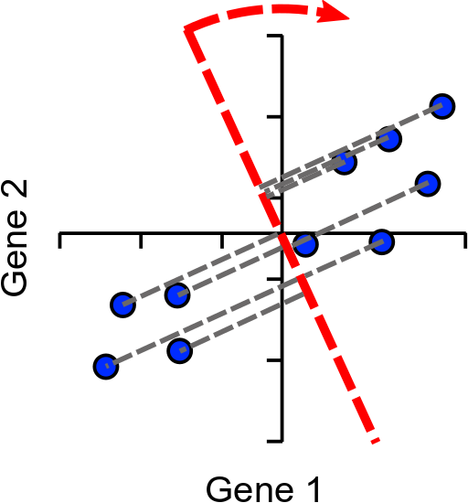
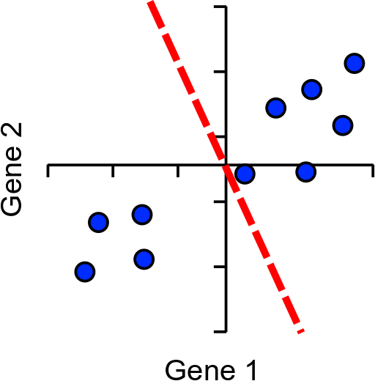
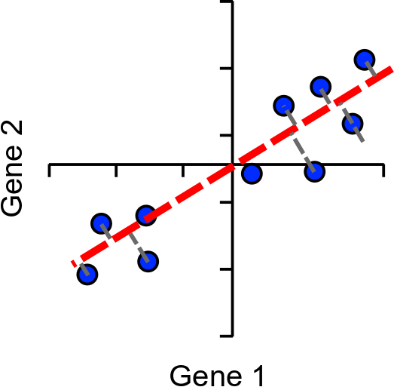
How does PCA work?
Find line of best fit, passing through the origin

Slide 10
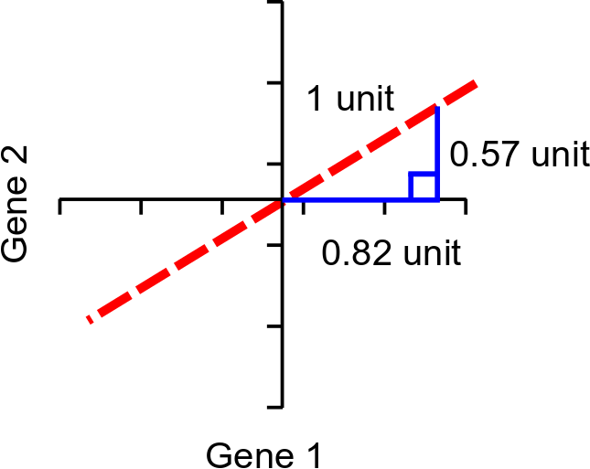
Assigning Loading to Genes
Single Vector or
‘eigenvector’
Loadings:
Gene1 = 0.82
Gene2 = 0.57
Higher loading equals more influence on PC

Slide 11
More Dimensions
The same idea extends to larger numbers of dimensions (n)
Calculation of first PC rotates in (n-1) -dimensions
Next PC is perpendicular to PC2, but rotated similarly (n-2)
Last PC is remaining perpendicular (no choice)
Same number of PCs as genes

Slide 12
Explaining Variance
Each PC always explains some proportion of the total variance in the data. Between them they explain everything
PC1 always explains the most
PC2 is the next highest etc. etc.
Since we only plot 2 dimensions we’d like to know that these are a good explanation
How do we calculate this?

Slide 13
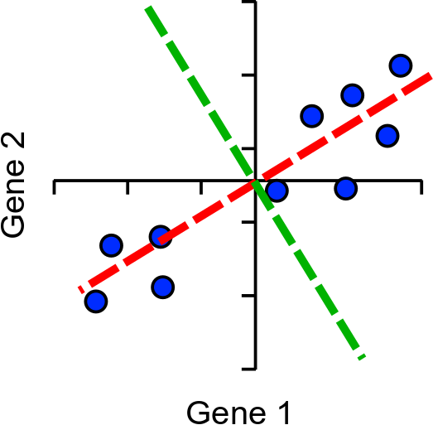
Explaining Variance
Project onto PC
Calculate distance to the origin
Calculate sum of squared differences (SSD)
This is a measure of variance called the ‘eigenvalue’
Divide by (points-1) to get actual variance

Slide 14
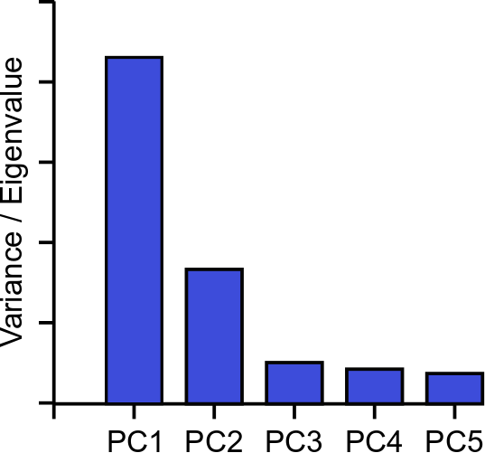
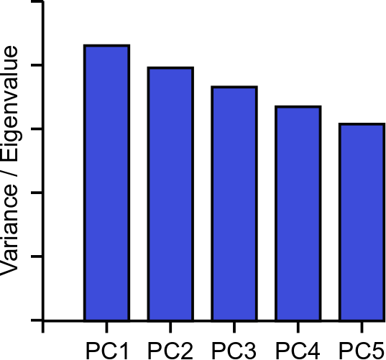
Explaining Variance – Scree Plots

Slide 15
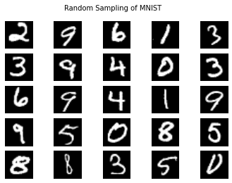
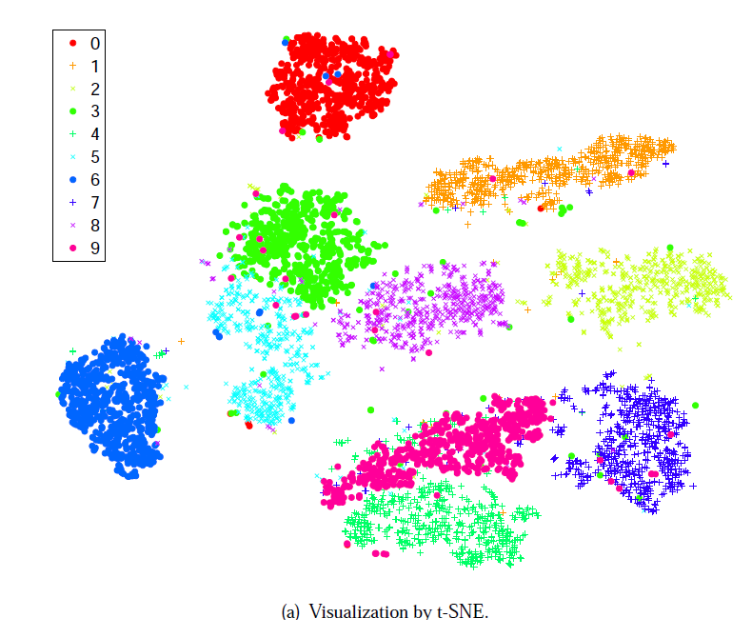
Problem: What if I have more than two really important PCA values
How can humans visualize high-dimensional data?
images (pixels can be considered dimensions)
single cell nuclei is described by 30 variables (variables = dimensions)
Specifically ...
How to visualize in 2D or 3D space?
to see relationships
check if features are separating the data
http://arxiv.org/pdf/1310.1531.pdf

Slide 16
What is t-SNE?
t-Distributed Stochastic Neighbor Embedding (t-SNE)
Unsupervised (does not use class labels)
Models the probabilities that high-d points xi,xj are neighbors
Models the probabilities the corresponding low-d
points yi,yj are neighbors
Finds a low-d representation that is faithful to the high-d model

Slide 17
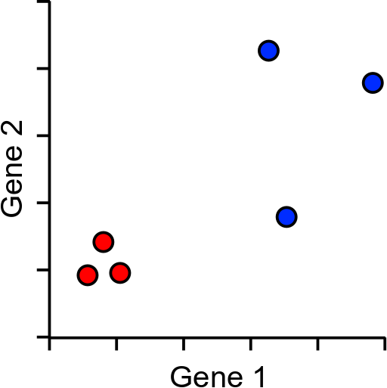
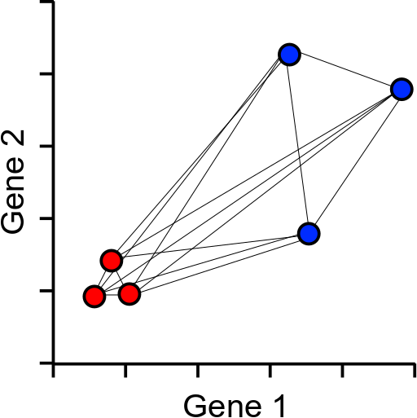
How does tSNE work?
Based around all-vs-all table of pairwise cell to cell distances

Slide 18
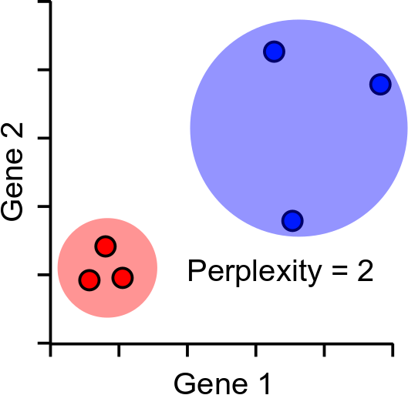
Distance scaling and perplexity
Perplexity = expected number of neighbours within a cluster
Distances scaled relative to perplexity neighbours
The performance of TSNE is fairly robust to changes in the perplexity, and typical values are between 5 and 50

Slide 19
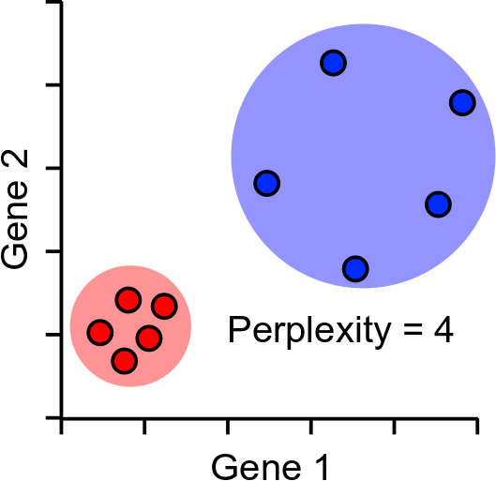
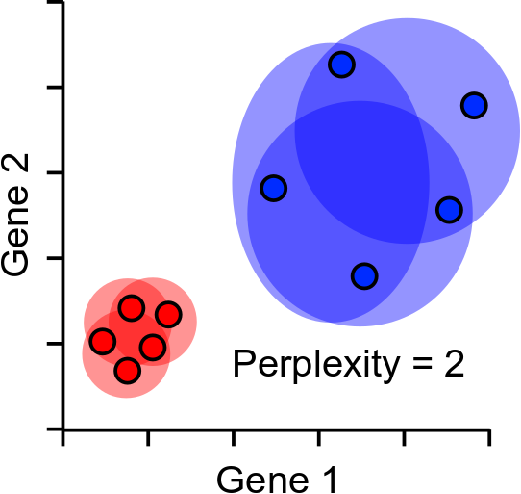
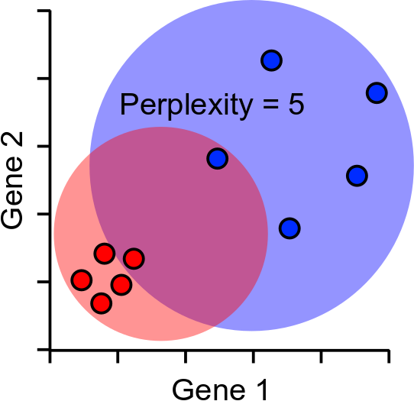
Perplexity Robustness

Slide 20
tSNE Projection
Normally projects in 2D, but can be any number of dimensions
Randomly scatter all points within the space
Start a simulation
Aim is to make the point distances match the distance matrix
Shuffle points based on how well they match
Stop after fixed number of iterations, or
Stop after distances have converged

Slide 21
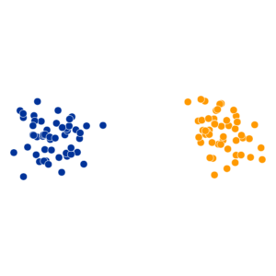
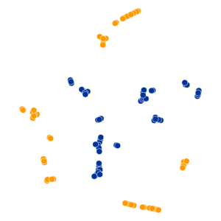
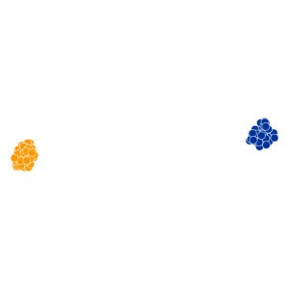
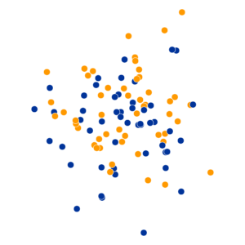
tSNE Practical Examples
Perplexity Settings Matter
Original
Perplexity = 2
Perplexity = 30
Perplexity = 100
https://distill.pub/2016/misread-tsne/

Slide 22
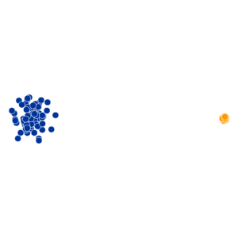
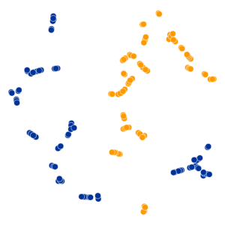
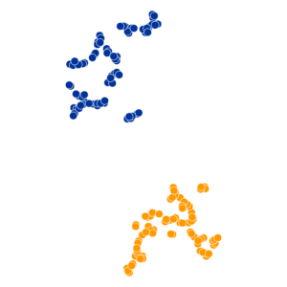
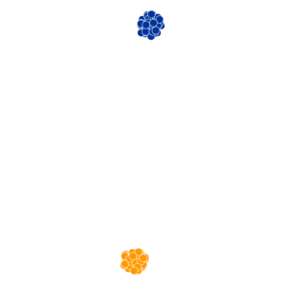
tSNE Practical Examples
Cluster Sizes are Meaningless
Perplexity = 2
Perplexity = 5
Perplexity = 50
https://distill.pub/2016/misread-tsne/

Slide 23
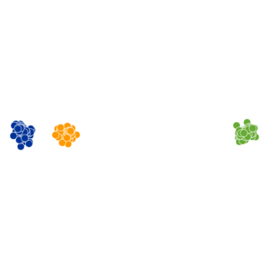
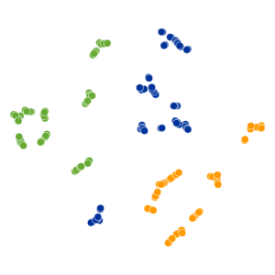
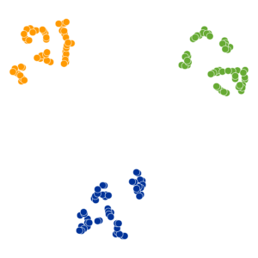
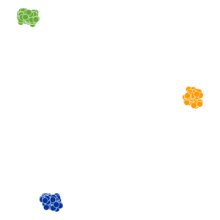
tSNE Practical Examples
Distances between clusters can’t be trusted
Perplexity = 2
Perplexity = 5
Perplexity = 30
https://distill.pub/2016/misread-tsne/

Slide 24
Shortcomings?
PCA
May Require more than 2 dimensions
Thrown off by quantised data
Expects linear relationships
tSNE
Can’t cope with noisy data
Loses the ability to cluster
Answer: Combine the two methods, get the best of both worlds
PCA
Good at extracting signal from noise
Extracts informative dimensions
tSNE
Can reduce to 2D well
Can cope with non-linear scaling
This is what CellRanger does in its default analysis

Slide 25
So PCA + tSNE is great then?
Up to some extent..
tSNE is slow. This is probably it’s biggest disadvantage
tSNE doesn’t scale well to large numbers of cells (10k+)
tSNE only gives reliable information on the closest neighbours
large distance information is almost irrelevant

Slide 26
UMAP to the rescue!
UMAP is a replacement for tSNE to fulfil the same role
Conceptually very similar to tSNE, but with a couple of relevant (and somewhat technical) changes
Practical outcome is:
UMAP is quite a bit quicker than tSNE
UMAP can preserve more global structure than tSNE*
UMAP can run on raw data without PCA preprocessing*
UMAP can allow new data to be added to an existing projection
* In theory, but possibly not in practice

Slide 27
UMAP differences
Instead of the single perplexity value in tSNE, UMAP defines
Nearest neighbours: the number of expected nearest neighbours – basically the same concept as perplexity
Minimum distance: how tightly UMAP packs points which are close together
Nearest neighbours will affect the influence given to global vs local information.
Min dist will affect how compactly packed the local parts of the plot are.

Slide 28
UMAP differences
Speed – mostly a level of maths I’m not going to get into!
UMAP skips a normalisation step in the calculation of high dimensional distances which speeds it up
In the 2D projection UMAP uses a more efficient method to shuffle the cells into their final position
Doesn’t have to measure every cell to decide on what to move
Uses an algorithm which can be multi-threaded
Algorithm is more deterministic, allowing more data to be projected later

Slide 29
Practical approach PCA + tSNE/UMAP
Filter heavily before starting
Nicely behaving cells
Expressed genes
Variable genes
Do PCA
Extract most interesting signal
Take top PCs. Reduce dimensionality (but not to 2)
Do tSNE/UMAP
Calculate distances from PCA projections
Scale distances and project into 2-dimensions

Slide 30
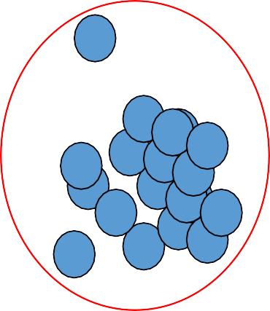
Clustering Motivation
The goal of clustering is to
group data points that are close (or similar) to each other
identify such groupings (or clusters) in an unsupervised manner
How to define similarity ?
How many iterations for checking cluster quality ?

Slide 31

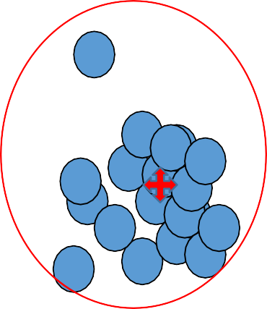
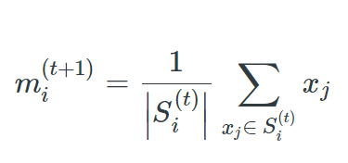
Cluster
A cluster is represented by a single point, known as centroid (or cluster center) of the cluster.
Centroid is computed as the mean of all data points in a cluster
Cluster boundary is decided by the farthest data point in the cluster.

Slide 32
Applications
Example 1: groups people of similar sizes together to make “small”, “medium” and “large” T-Shirts.
Tailor-made for each person: too expensive
One-size-fits-all: does not fit all.
Example 2: In marketing, segment customers according to their similarities
To do targeted marketing.
Example 3: Given a collection of text documents, we want to organize them according to their content similarities,
To produce a topic hierarchy

Slide 33
Types of clustering
Clustering: Task of grouping a set of data points such that data points in the same group are more similar to each other than data points in another group (group is known as cluster)
it groups data instances that are similar to (near) each other in one cluster and data
instances that are very different (far away) from each other into different clusters.
Types:
Exclusive Clustering: K-means
Overlapping Clustering: Fuzzy C-means
Hierarchical Clustering: Agglomerative clustering, divisive clustering
PCA
T-SNE
UMAP

Slide 34
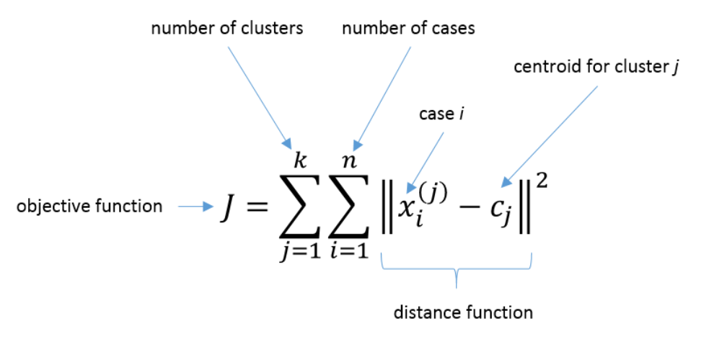
1. Exclusive clustering: K-means
Basic idea: randomly initialize the k cluster centers, and iterate between the two
steps explained below.
Randomly initialize the cluster centers, c₁, ..., c_{K}
Given cluster centers, determine points in each cluster
For each point p, find the closest c_{i}. Put p into cluster i
Given points in each cluster, solve for c_{i}
Set c_{i} to be the mean of points in cluster i
If c_{i} have changed, repeat Step 2

Slide 35
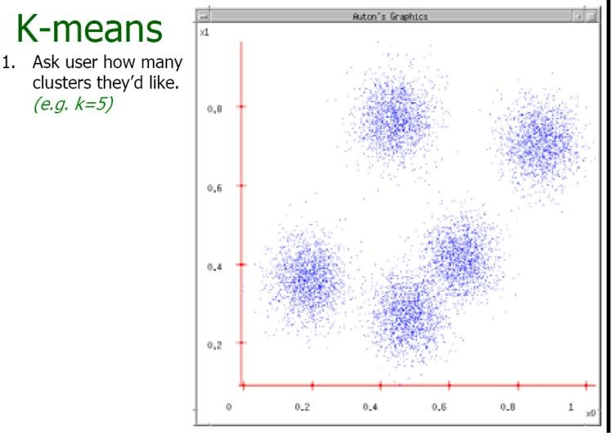
K-means example
This slide is taken from: Andrew Moore

Slide 36
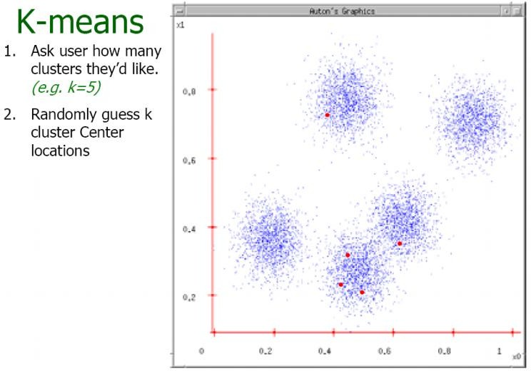
Example contd..
This slide is taken from: Andrew Moore

Slide 37
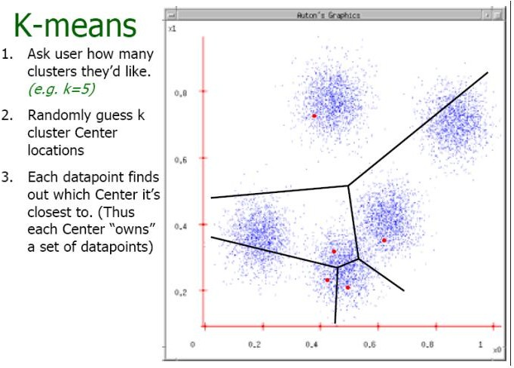
Example contd..
This slide is taken from: Andrew Moore

Slide 38
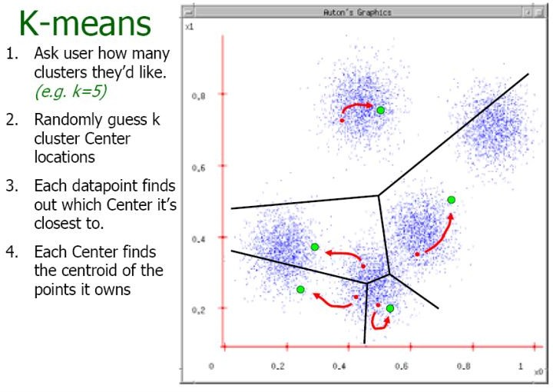
Example contd..
This slide is taken from: Andrew Moore

Slide 39
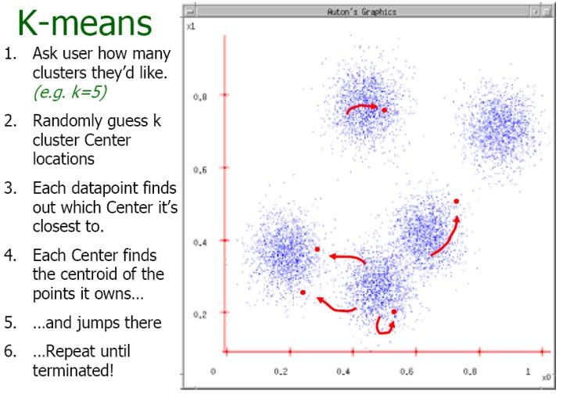
Example contd..
This slide is taken from: Andrew Moore

Slide 40
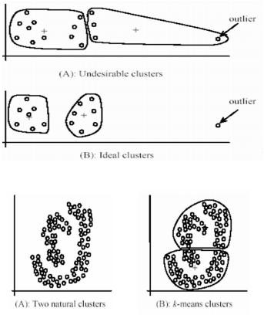
Contd..
Pros
Simple, fast to compute
Converges to local minimum of within-cluster squared error
Cons
Setting k?
Sensitive to initial centers
Sensitive to outliers
Detects spherical clusters
Assuming means can be computed
Image source: Google

Slide 41
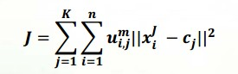
2. Fuzzy C-Means Clustering
One data point may belong to two or more cluster with different memberships.
Objective function:
where 1 ≤ m< ∞
An extension of k-means

Slide 42
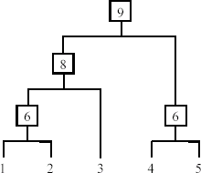
3. Hierarchical Clustering
Produce a nested sequence of clusters, a tree, also called Dendrogram.

Slide 43
Types of hierarchical clustering
Agglomerative (bottom up) clustering: It builds the dendrogram (tree) from the bottom level, and
merges the most similar (or nearest) pair of clusters
stops when all the data points are merged into a single cluster (i.e., the
root cluster).
Divisive (top down) clustering: It starts with all data points in one cluster, the root.
Splits the root into a set of child clusters. Each child cluster is recursively divided further
stops when only singleton clusters of individual data points remain, i.e.,
each cluster with only a single point
This slide is taken from Bing Liu, UIC
23

Slide 44
Agglomerative clustering
It is more popular than divisive methods.
At the beginning, each data point forms a cluster (also called a node).
Merge nodes/clusters that have the least distance.
Go on merging
Eventually all nodes belong to one cluster
24

Slide 45
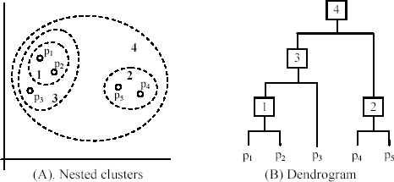
An example: working of the algorithm
This slide is taken from Bing Liu, UIC
25

Slide 46
Hierarchical clustering
Pros
Dendograms are great for visualization
Provides hierarchical relations between clusters
Shown to be able to capture concentric clusters
Cons
Not easy to define levels for clusters
Experiments showed that other clustering techniques outperform
hierarchical clustering

Slide 47
Normalization
Technique to force the attributes to have a common value range
What is the need ?
Consider the following pair of data points
x_{i}: (0.1, 20) and x_{j}: (0.9, 720).
dist(x_{i} , x _{j} ) = (0.9 − 0.1)² + (720− 20)² = 700.000457,
Two main approaches to standardize interval scaled attributes, range and z-score. f is an attribute
^{x}if
min( f )
range(x ) =
,
if
max( f ) − min( f )

Slide 48
Contd..
Z-score: transforms the attribute values so that they have a mean of zero and a mean absolute deviation of 1. The mean absolute deviation of attribute f, denoted by s_{f}, is computed as follows
m = ¹ (x + x + ... + x ),
f
n
1 f 2 f nf
s = ¹ (| x
− m |),
m
| + | x
− m | +...+ | x
f
n
1 f
f
2 f
f
nf
f
x − m_{f .}
Z-score:
z(x ) =
if
if
s
f

Slide 49
How to choose a clustering algorithm
A vast collection of algorithms are available. Which one to choose for our problem ?
Choosing the “best” algorithm is a challenge.
Every algorithm has limitations and works well with certain data distributions.
It is very hard, if not impossible, to know what distribution the application data follow. The data may not fully follow any “ideal” structure or distribution required by the algorithms.
One also needs to decide how to standardize the data, to choose a suitable distance function and to select other parameter values.

Slide 50
Contd..
Due to these complexities, the common practice is to
run several algorithms using different distance functions and parameter settings, and
then carefully analyze and compare the results.
The interpretation of the results must be based on insight into the meaning of the original data together with knowledge of the algorithms used.
Clustering is highly application dependent and to certain extent subjective (personal preferences).

Slide 51
Summary
Studied need for unsupervised learning
Types of clustering dimensionality reduction:
K-means, hierarchical, PCA, t-SNE, UMAP
Similarity functions:
Euclidean distance, Manhattan distance
Stopping criteria:
SSD
Which algorithm to choose

